Slide 1
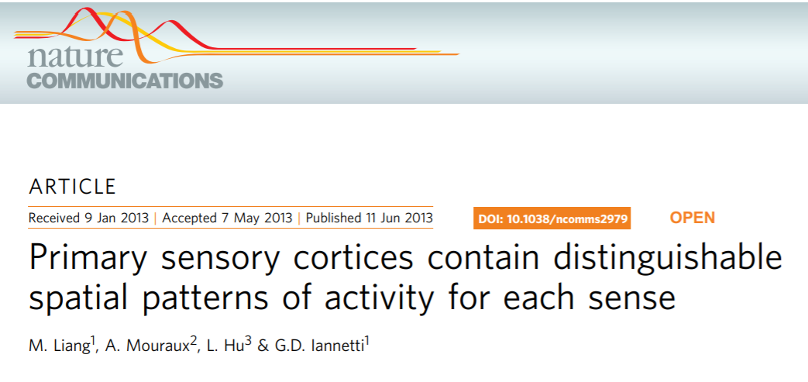

Slide 2
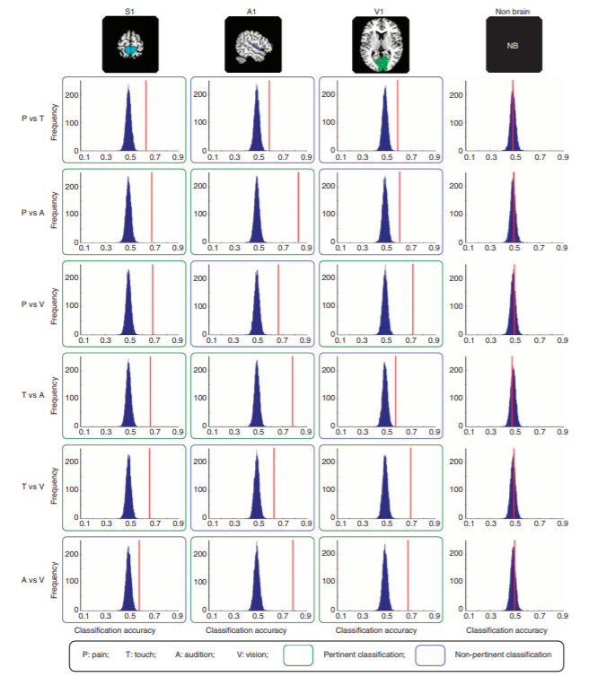

Slide 3
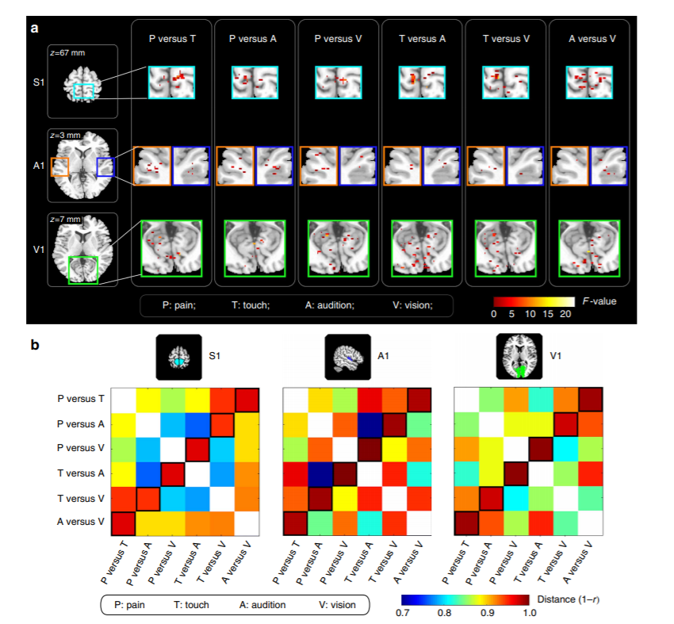

Slide 4
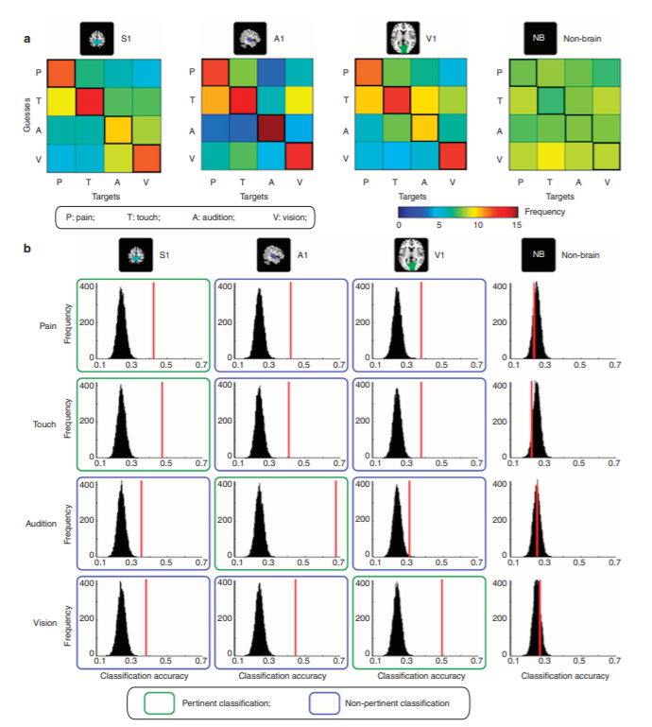
the prediction of target stimuli whose modality corresponds to the modality of the ROI
even for four-way classifications,
distributed spatial pattern of BOLD responses
in any given primary sensory area
can reliably predict the modality of the eliciting stimulus, regardless of whether its sensory modality
matches that of the primary sensory area.

Slide 5
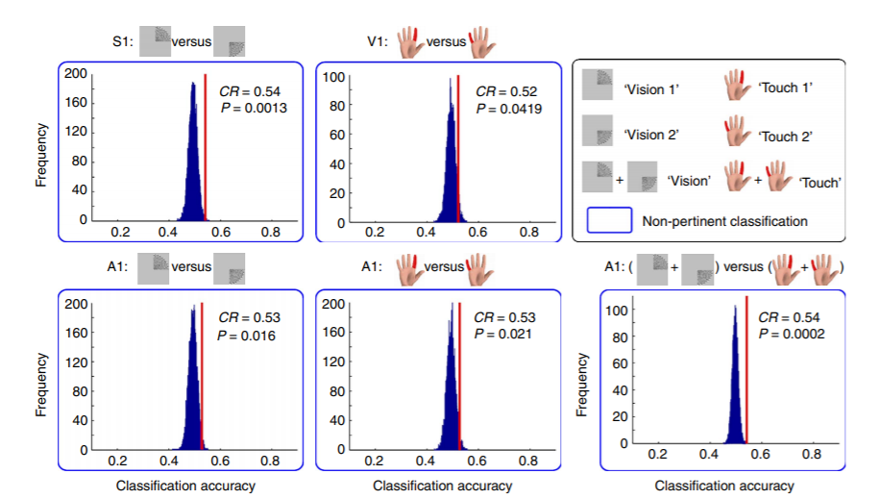

Slide 6
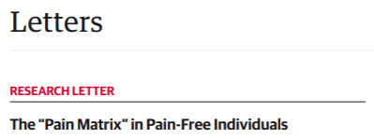

Slide 7
